Slide 1

E PROJECT:
Alberto Clocks
User guide

Slide 2
E PROJECT GROUP MEMBERS
Students Name
Students ID
Tooba Khan
Student1729672
Alvina
Student1731026
Yusra Ilyas
Student1729666
Urooj Fatima
Student1730903
Faculty Name: Sir Maaz Rahim
Coordinator Name: Miss Ashna Nasir

Slide 3
NAVBAR

Slide 4
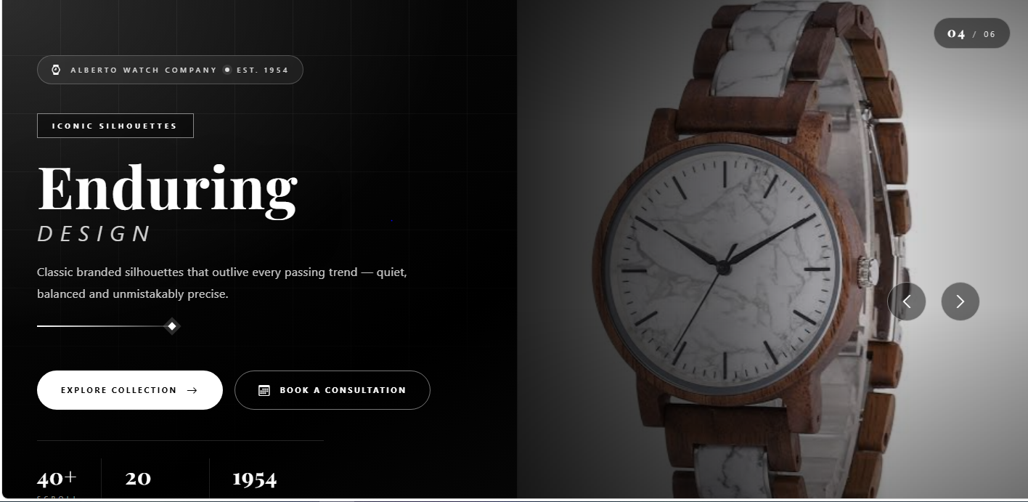
HOME PAGE

Slide 5
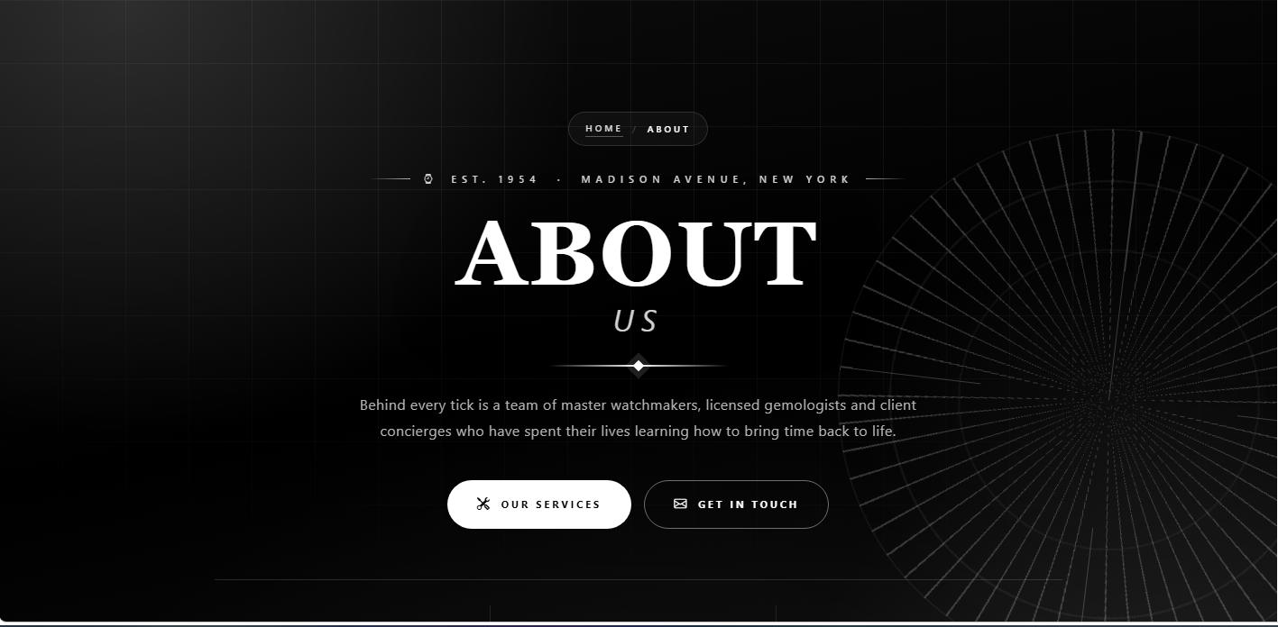
ABOUT PAGE

Slide 6

SERVICE PAGE

Slide 7
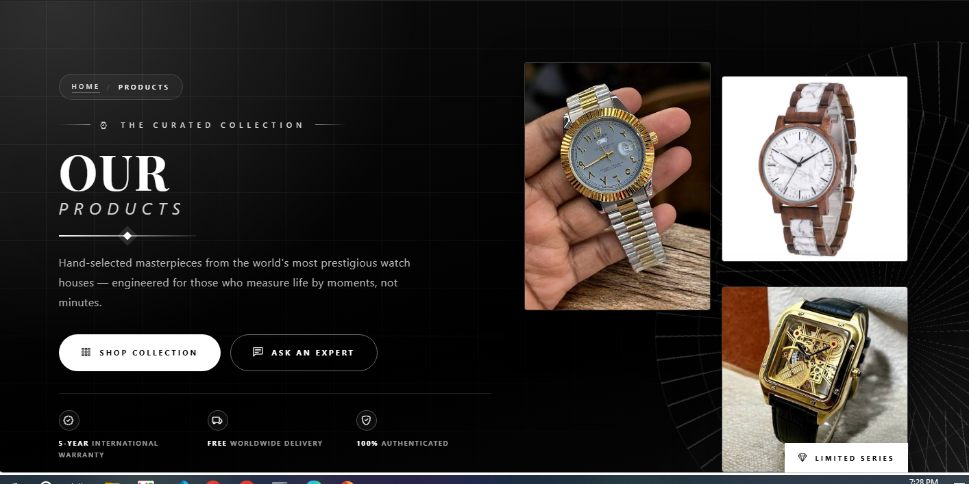
PRODUCTS PAGE

Slide 8
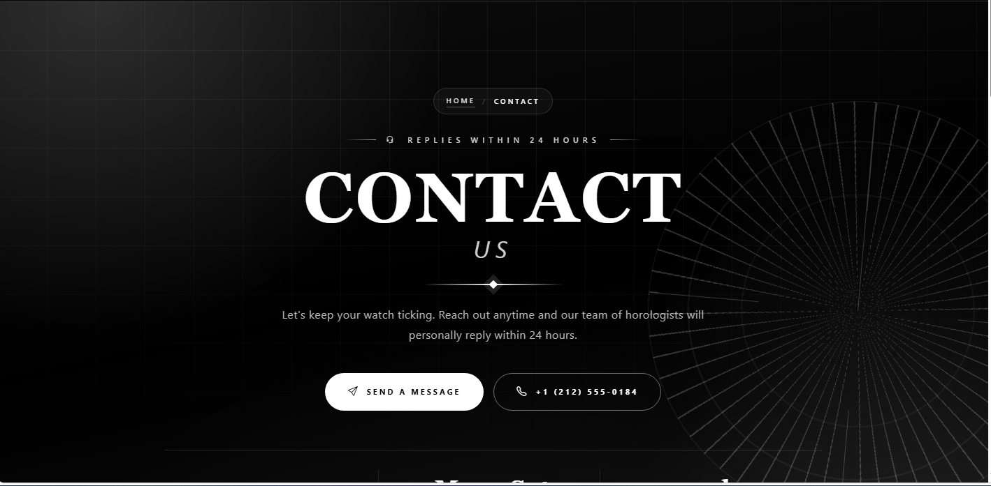
CONTACT PAGE

Slide 9
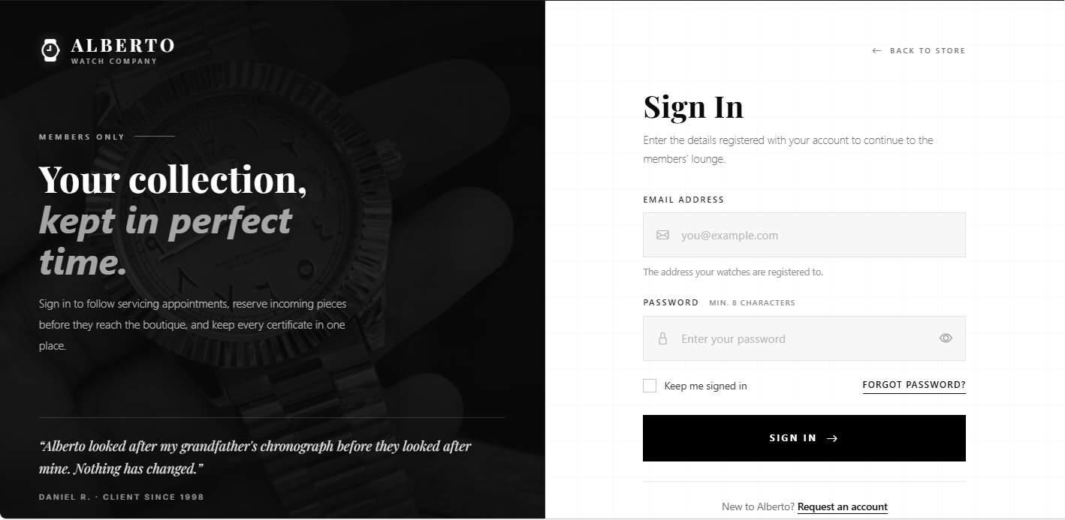
LOGIN PAGE

Slide 10
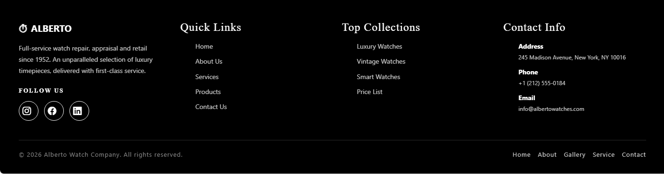
FOOTER

Slide 11
THANK YOU

